Slide 1

Bank Loan Case Study
By Divyasri Jegan

Slide 2
Introduction:
Welcome to the comprehensive case study on bank loans, a critical aspect of financial services that significantly impacts both individuals and businesses. This study delves into the mechanisms, challenges, and outcomes associated with bank loans, providing an in-depth analysis of the loan process from application to repayment.This project is about the analysis of Bank Loan case study.

Slide 3
Project Description :
Imagine you're a data analyst at a finance company that specializes in lending various types of loans to urban customers. Your company faces a challenge: some customers who don't have a sufficient credit history take advantage of this and default on their loans. Your task is to use Exploratory Data Analysis (EDA) to analyze patterns in the data and ensure that capable applicants are not rejected.
The case study is given with three datasets:
Previous_data previous_dataset
Application_data application_dataset
Column_data column data

Slide 4
Company’s perspective :
When a customer applies for a loan, your company faces two risks:
If the applicant can repay the loan but is not approved, the company loses business.
If the applicant cannot repay the loan and is approved, the company faces a financial loss.
Two types of scenarios:
Customers with payment difficulties: These are customers who had a late payment of more than X days on at least one of the first Y installments of the loan.
All other cases: These are cases where the payment was made on time.
When a customer applies for a loan, there are four possible outcomes:
Approved: The company has approved the loan application.
Cancelled: The customer cancelled the application during the approval process.
Refused: The company rejected the loan.
Unused Offer: The loan was approved but the customer did not use it.

Slide 5
Approach:
01 Introduction
02 Project Description
03 Tech Stack Used
04 Insights
05 Analysis
06 Result
07 Conclusion

Slide 6
Tech Stack Used :
Microsoft Excel
Used for data cleaning and EDA analysis to make interactive graphs
PowerPoint
To make ppts and also represent my projects in a interactive way.

Slide 7
Business Objective :
The main aim of this project is to identify patterns that indicate if a customer will have difficulty paying their installments. This information can be used to make decisions such as denying the loan, reducing the amount of loan, or lending at a higher interest rate to risky applicants. The company wants to understand the key factors behind loan default so it can make better decisions about loan approval.
Note: To better understand this project, you might want to research a bit about risk analytics in banking and financial services. Understanding the types of variables and their significance should be enough.

Slide 8
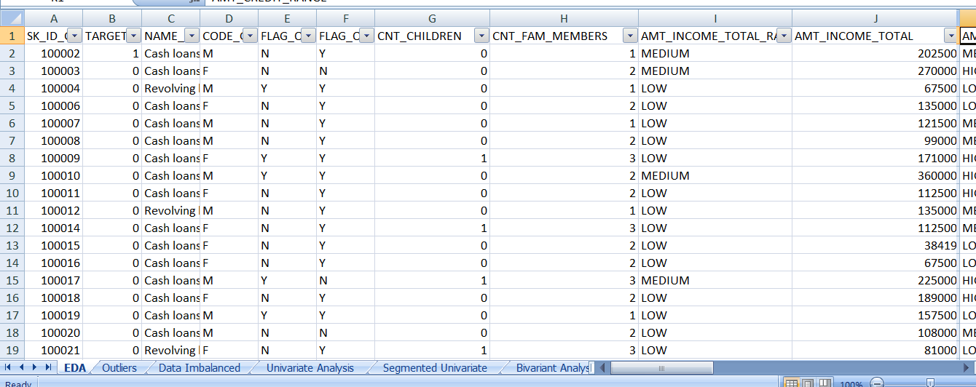
Insights:
1) Identify Missing Data and Deal with it Appropriately: As a data analyst, you come across missing data in the loan application dataset. It is essential to handle missing data effectively to ensure the accuracy of the analysis.
Task: Identify the missing data in the dataset and decide on an appropriate method to deal with it using Excel built-in functions and features.
Using EDA analysis and COUNTA and NULL function I have handled the missing values of given dataset.

Slide 9
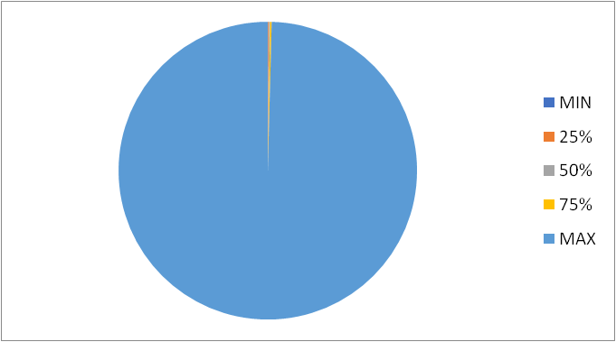
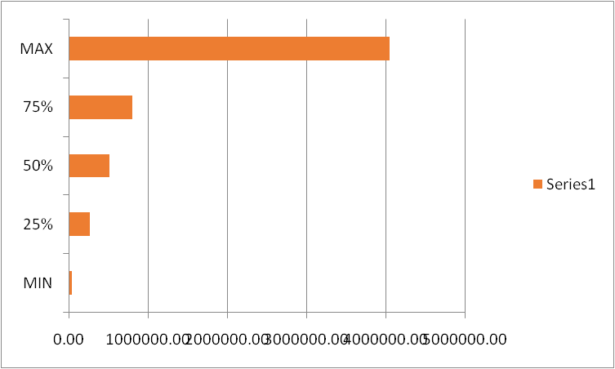
2). Identify Outliers in the Dataset: Outliers can significantly impact the analysis and distort the results. You need to identify outliers in the loan application dataset.
Task: Detect and identify outliers in the dataset using Excel statistical functions and features, focusing on numerical variables.
Outliers in AMT_ANNUITY
AMT_CREDIT

Slide 10
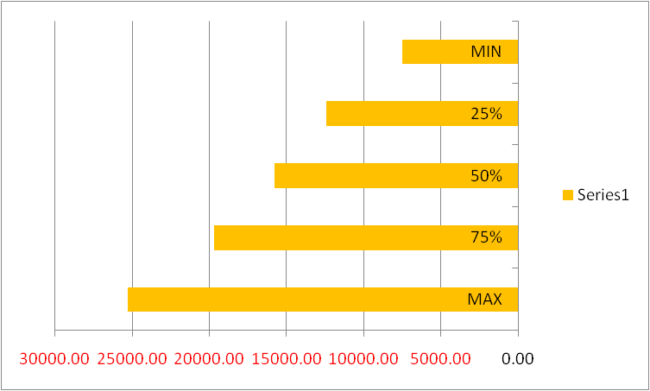
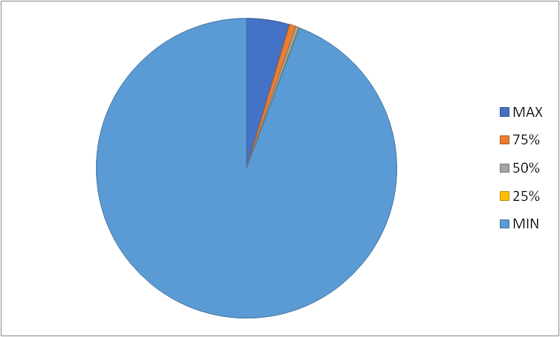
Outliers in DAYS_OF_BIRTH and
DAYS_EMPLOYED

Slide 11
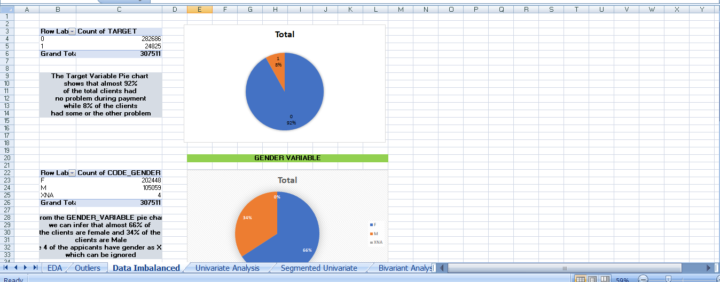
3) Analyze Data Imbalance: Data imbalance can affect the accuracy of the analysis, especially for binary classification problems. Understanding the data distribution is crucial for building reliable models.
Task: Determine if there is data imbalance in the loan application dataset and calculate the ratio of data imbalance using Excel functions.
The missing data is handled and also the data with outlier is made and imbalance data have me cleared to make a accurate insights providing dataset was made.

Slide 12
4) Perform Univariate, Segmented Univariate, and Bivariate Analysis: To gain insights into the driving factors of loan default, it is important to conduct various analyses on consumer and loan attributes.
Task: Perform univariate analysis to understand the distribution of individual variables, segmented univariate analysis to compare variable distributions for different scenarios, and bivariate analysis to explore relationships between variables and the target variable using Excel functions and features.
UNIVARIATE ANALYSIS
Univariate analysis
is the simplest form of analyzing data, where the data has only one variable. It involves analyzing each variable separately, without considering the relationships between variables.
SEGMENTED UNIVARIATE ANALYSIS
Segmented univariate analysis can be used to find summary of a single data variable in the form of segments. It also used to detect the central tendencies such as mean,median,mode; variance and standard deviation.
BIVARIATE ANALYSIS
Bivariate analysis is one of the simplest forms of quantitative (statistical) analysis. It involves the analysis of two variables (often denoted as X, Y), for the purpose of determining the empirical relationship between them. Bivariate analysis can be helpful in testing simple hypotheses of x and y.

Slide 13
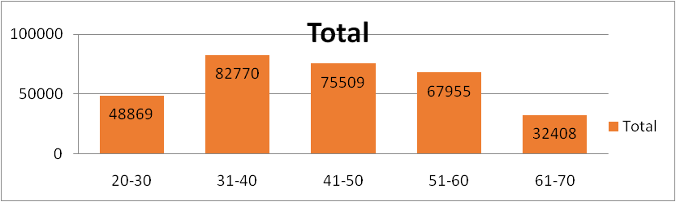
Row Labels | Count of YEARS_BIRTH_RANGE
20-30 | 48869
31-40 | 82770
41-50 | 75509
51-60 | 67955
61-70 | 32408
Grand Total | 307511
From the adjacent bar plot we can infer that most of the applicants belong to the Age Group ’31-40’.

Slide 14
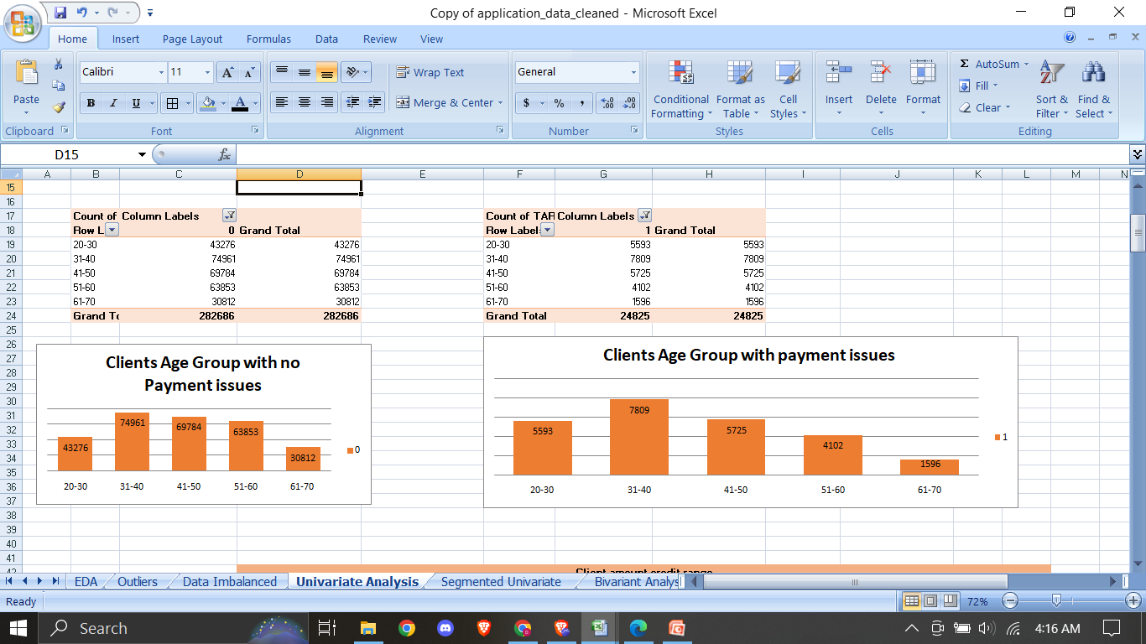
From the adjacent Bar plot we can infer that clients/applicants in the Age Group ’31-40’ are having the highest number when it comes to doing/returning Payment to Banks

Slide 15
From the adjacent Bar plot we can infer that clients/applicants in the Age Group ’31-40’ are having the highest number of payment issues when it comes to doing/returning Payment to Banks

Slide 16
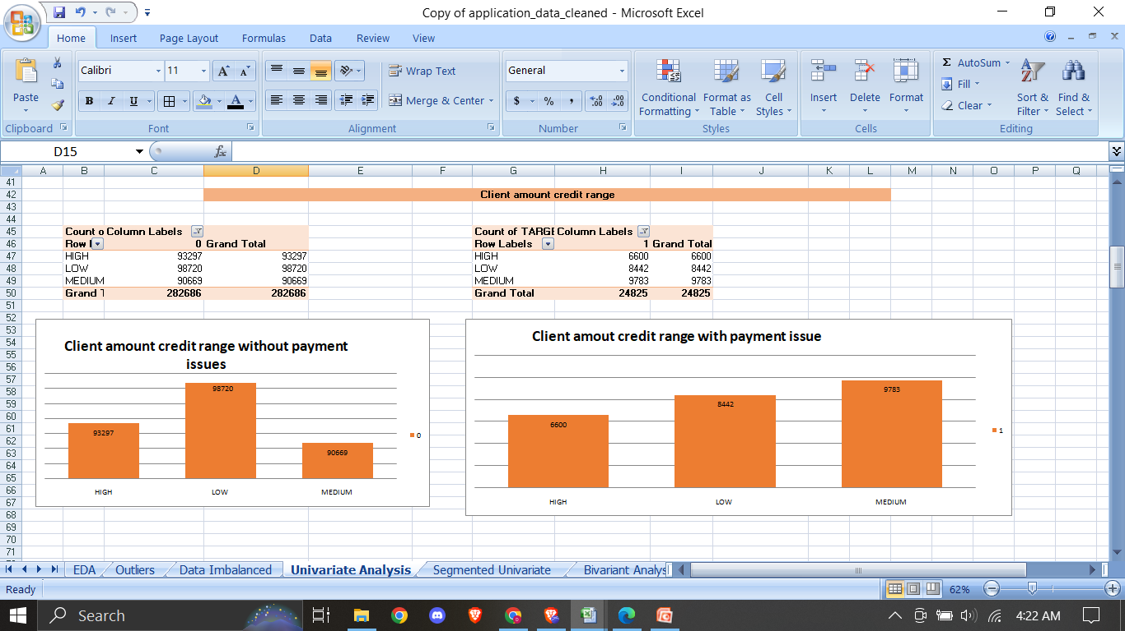
From the adjacent Bar plot we can infer that clients belonging to ‘Low’ income range have the highest count when it comes to clients with no payment issues
From the adjacent Bar plot we can infer that clients belonging to ‘Medium’ income range have the highest count when it comes to clients with payment issues

Slide 17
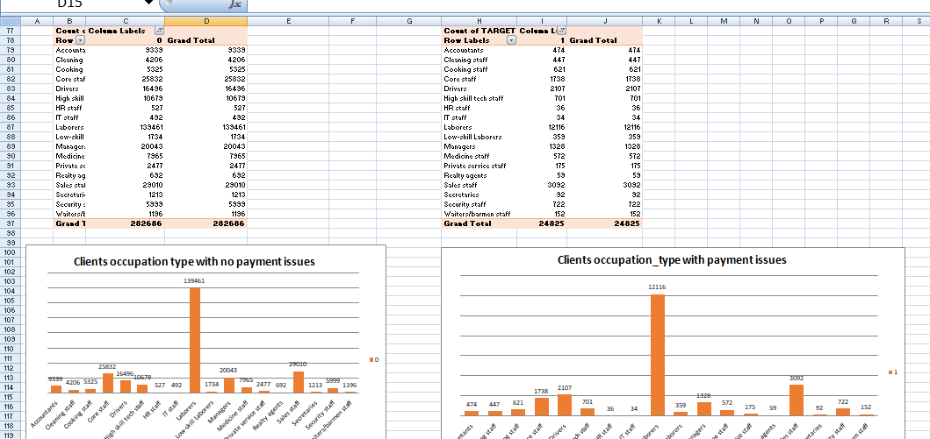
From the above bar plot we can infer that clients with occupation_type ‘Laborers’ have the highest number of count when it comes to clients with no payment issues
From the above bar plot we can infer that clients with occupation_type ‘Laborers’ have the highest number of count when it comes to clients with payment issues

Slide 18
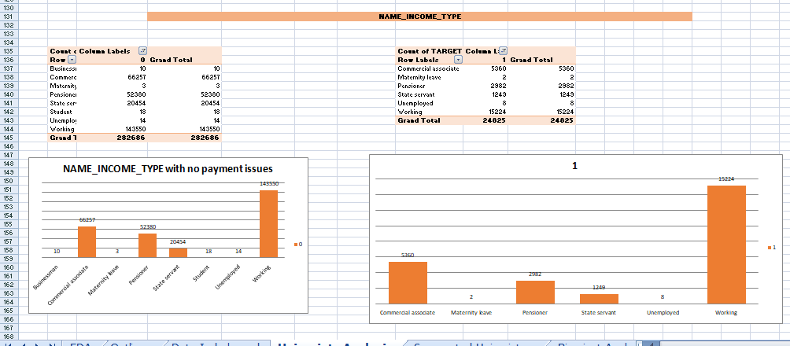
– From the above Bar plot we can infer that clients having income_type as ‘WORKING’ have the highest count when it comes to clients with no payment issues
– From the above Bar plot we can infer that clients having income_type as ‘WORKING’ have the highest count when it comes to clients with payment issues

Slide 19
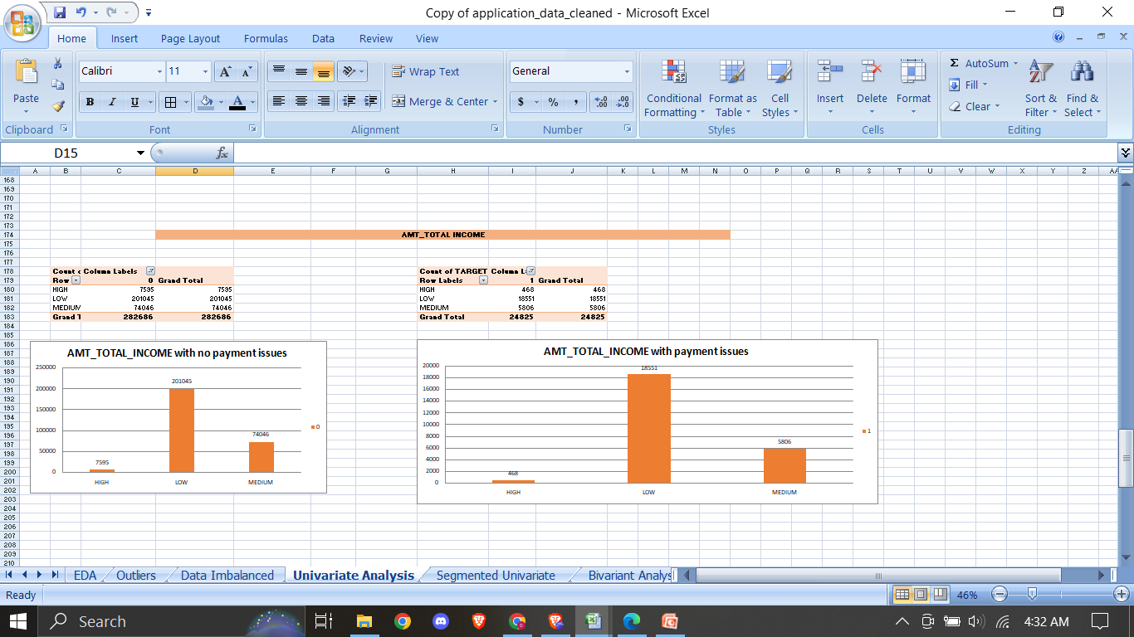
– From the above Bar plot we can infer that client having the total income range as ‘LOW’ have the highest count when it comes to clients having no payment issues
– From the above Bar plot we can infer that client having the total income range as ‘LOW’ have the highest count when it comes to clients having payment issues

Slide 20
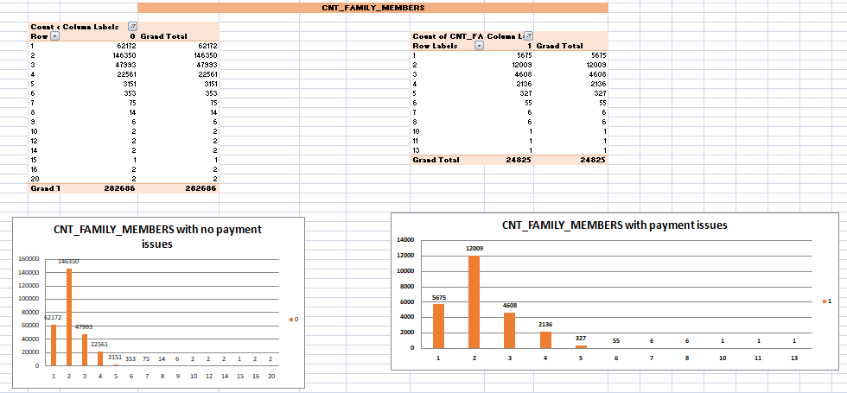
– From the above Bar plot we can infer that clients having total count of family members as 2 have the highest count when it comes to clients having no payment issues
– From the above Bar plot we can infer that clients having total count of family members as 2 have the highest count when it comes to clients having payment issues

Slide 21
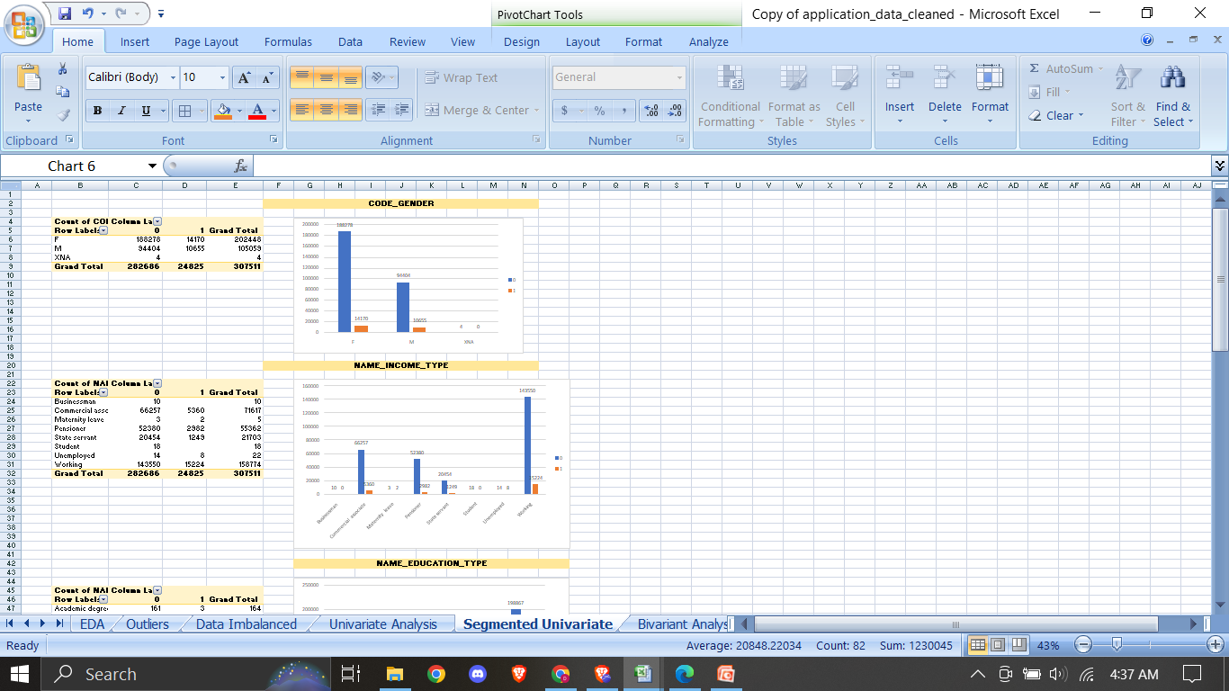
Segmented Univariate Analysis:

Slide 22
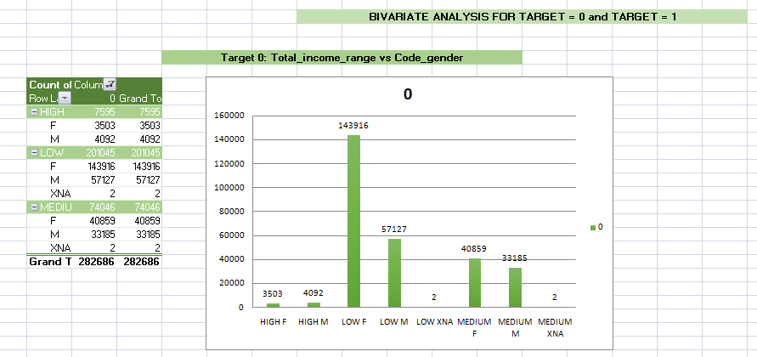
Bivariate Analysis :
From the above Bar plot we can infer that Females belonging to Low income group are the highest number of clients with no payment issues

Slide 23
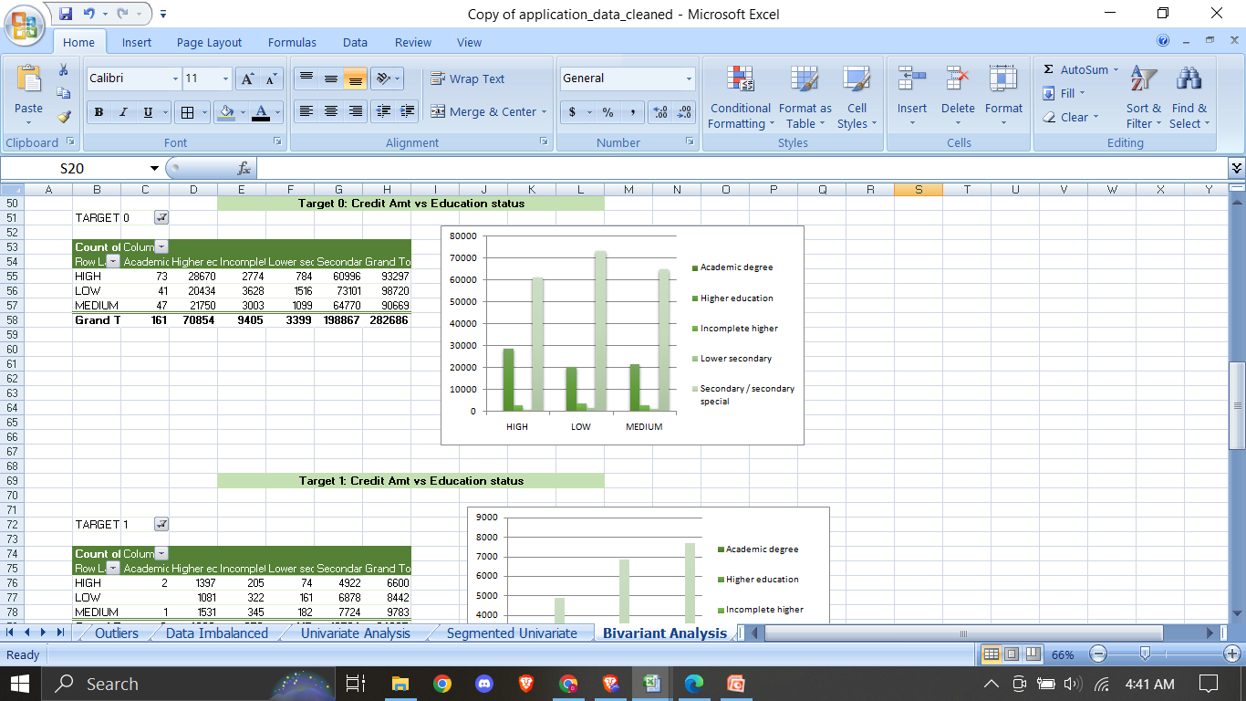
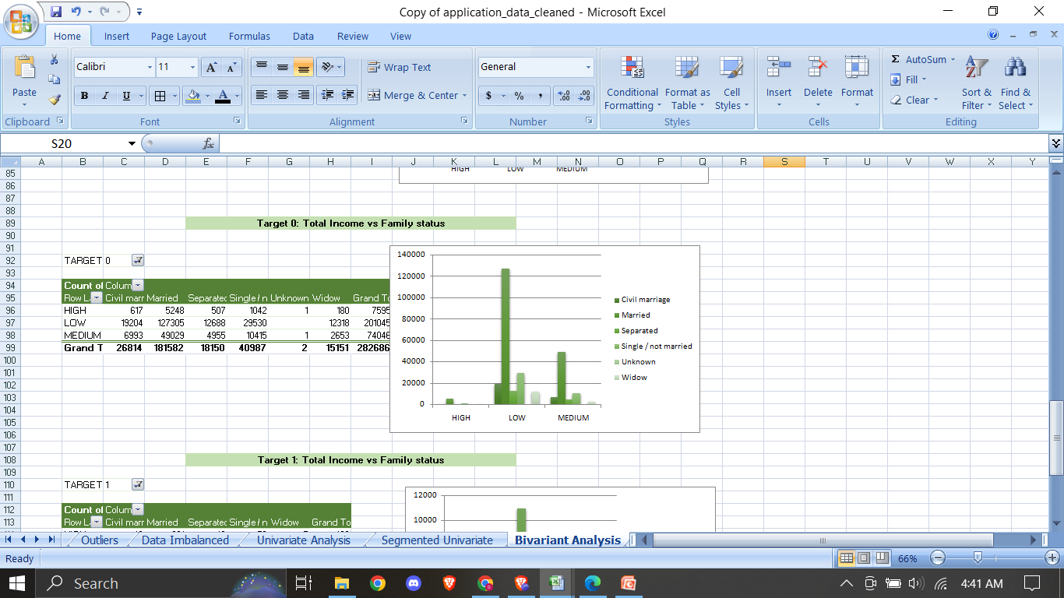
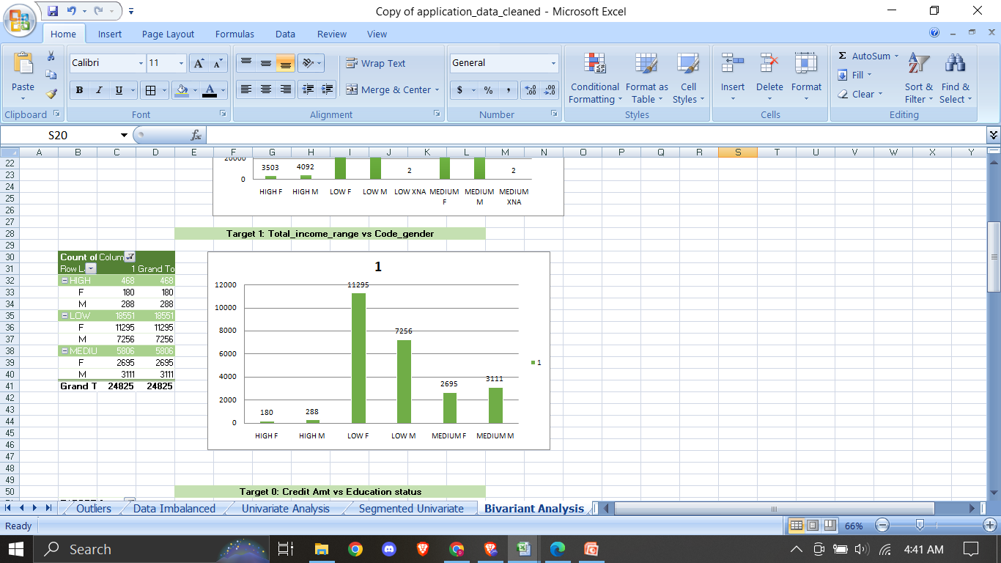
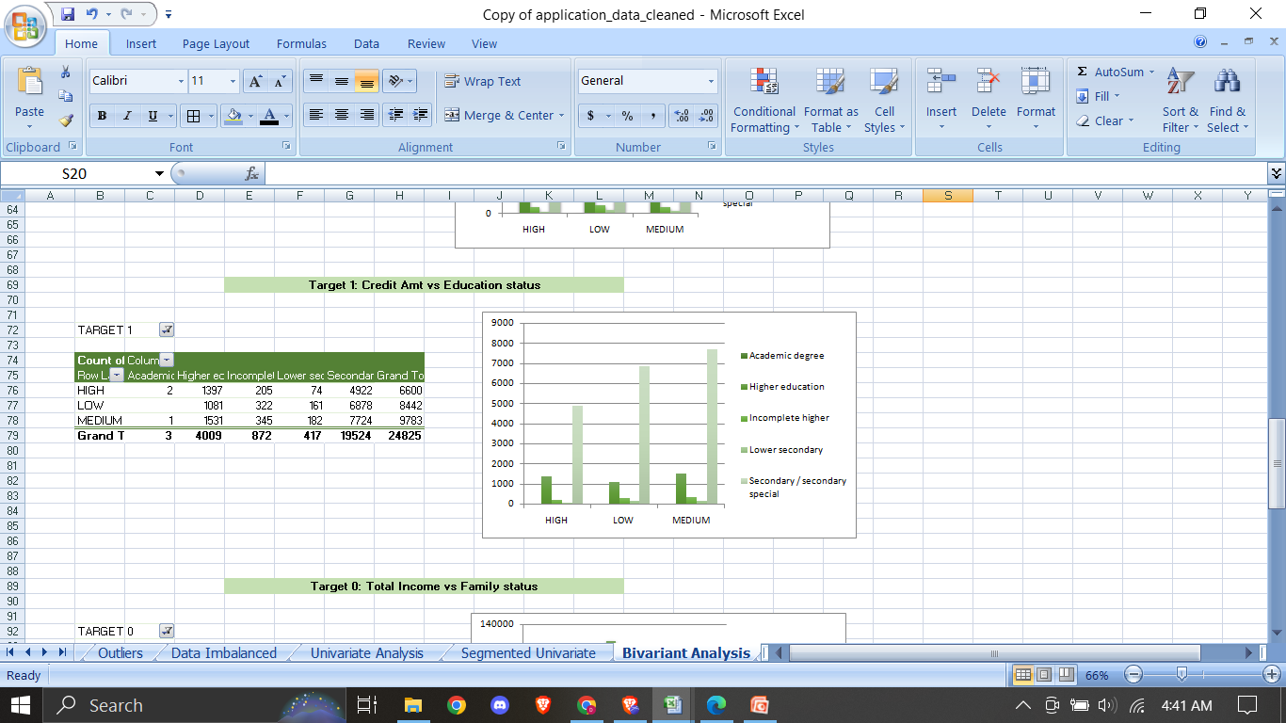

Slide 24
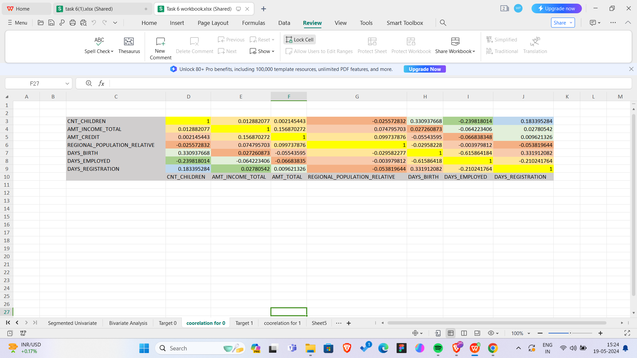
5) Identify Top Correlations for Different Scenarios: Understanding the correlation between variables and the target variable can provide insights into strong indicators of loan default.
Task: Segment the dataset based on different scenarios (e.g., clients with payment difficulties and all other cases) and identify the top correlations for each segmented data using Excel functions.
Correlation for target 0

Slide 25
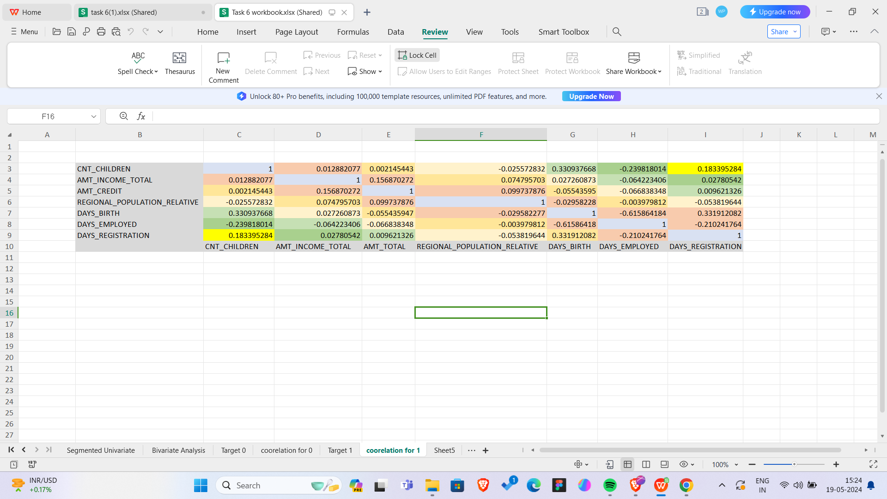
Correlation for Target 1

Slide 26
Result:
Hence the analysis are being done on both datasets Applications Dataset and Precious Applications Dataset
The following conclusions were drawn from the analysis done
•The proportion/percentage of the defaulters(target = 1) is around 8% and that of non-defaulters(target = 0) is around 92%
•The Bank generally lends more loan to Female clients as compared to Males clients as the count of Female clients in the defaulter’s list is less than that of Males. Still Bank can look for more Male clients if their credit amount is satisfied
•Also the clients who belong to Working class tend to pay their loans on time followed by the clients who fall under Commercial Associate

Slide 27
Clients having Education status like Secondary/ Higher Secondary or more tend to pay loan on time so bank can prefer lending loans to clients having such Education Status
Clients who fall in the Age Group 31-40 have the highest count for paying off their loans on time followed by the clients who fall in the Age Groups 41-60
Clients having LOW credit amount range tend to pay off their loans on time than compared to HIGH and MEDIUM credit range
Clients living with their Parents tend to pay off their loans quickly as compared to other housing type. So Bank can lend loan to clients having housing type à Living with Parents

Slide 28
•Clients taking loan for purchasing New Home i.e. clients taking Home Loans or purchasing New Car i.e. Car Loans and clients who have a income type as State Servant tend to pay their loans on time and hence Bank should prefer clients having such background
•The Bank should be more cautious when lending money to clients with Repairs purpose because they have high count of Defaulters along with High count of Defaulters
Task 6 Workbook: application data.xlsx
Task 6 presentation : Presentation

Slide 29
Conclusion:
Thus the solution to the given case study was found.
I have able to create decision and do analysis on a large dataset.
It involved EDA method and also you data visualization technique to provide a understandable graphs that makes it easy for understandable and every step made me to get strong knowledge in MS Excel.

